Slide 1

Integrating Web 2.0 Tools In The World Language Classroom
By: Christine S. Stanley and Giuliana F. Chapman
April 21, 2012
Session 79
1:00 – 2:00 PM

Slide 2
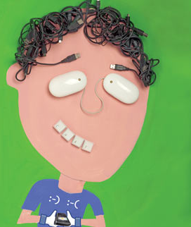
Our Students

Slide 3
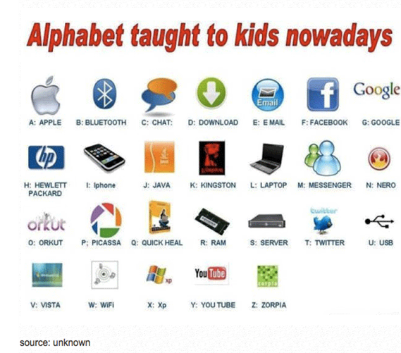
2012

Slide 4
What is Web 2.0?
Web 2.0 is the term given to describe a second generation of the World Wide Web that is focused on the ability for people to collaborate and share information online. Web 2.0 basically refers to the transition from static HTML Web pages to a more dynamic Web that is more organized and is based on serving web applications to users. Other improved functionality of Web 2.0 includes open communication with an emphasis on web-based communities of users, and more open sharing of information. Over time Web 2.0 has been used more as a marketing term than a computer-science-based term. Blogs, wikis, and web services are all seen as components of Web 2.0.
Source- Webopedia http://www.webopedia.com/

Slide 5

Technology can seem…
Word Cloud by

Slide 6

Technology can foster…

Slide 7
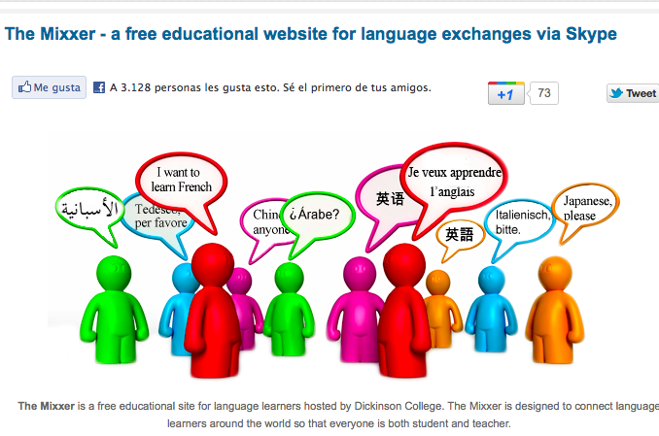
Online Language Exchange Programs
The Mixxer
Language exchange program from Dickinson College via Skype
Talk with native speakers over Skype
Use as an individual or as a large group

Slide 8
More Online Language Exchange Communities
MyLanguage Exchange
Shared Talk by Rosetta Stone

Slide 9
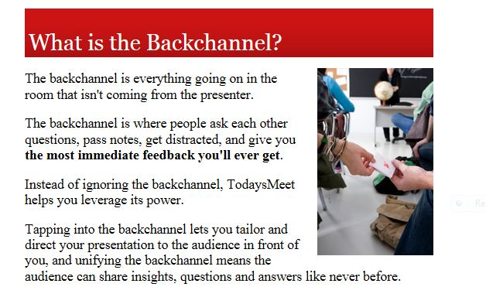
Live Streaming and Backchanneling
Ustream
Broadcast video live around the world. Videos can be viewed on smartphones, iPads, iPhones, Tablets, etc…
Students can post comments and videos
TodaysMeet

Slide 10
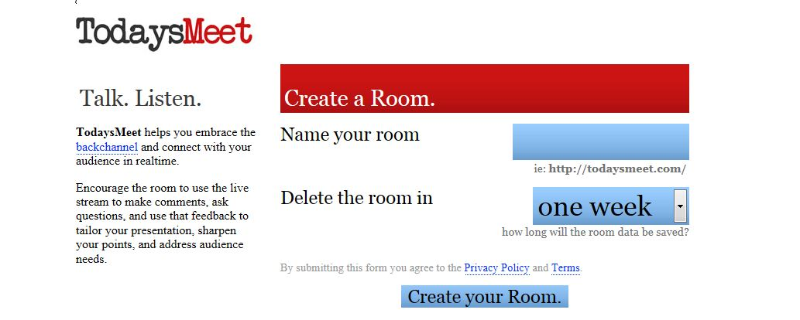
TodaysMeet

Slide 11
Text to Speech
Text to Speech
This language portal can “read” text that has been added in the target language.
  Example in Italian
  Example in French
Students can replay the file to practice their pronunciation or to “check” a paper by listening for errors that they miss in written text.

Slide 12
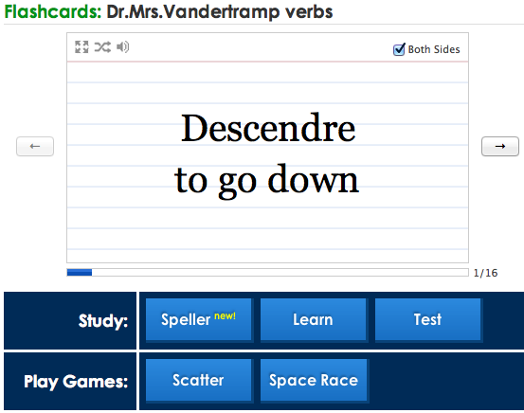
Vocabulary Builder
Quizlet (Online Flashcards with Sound Files)

Slide 13
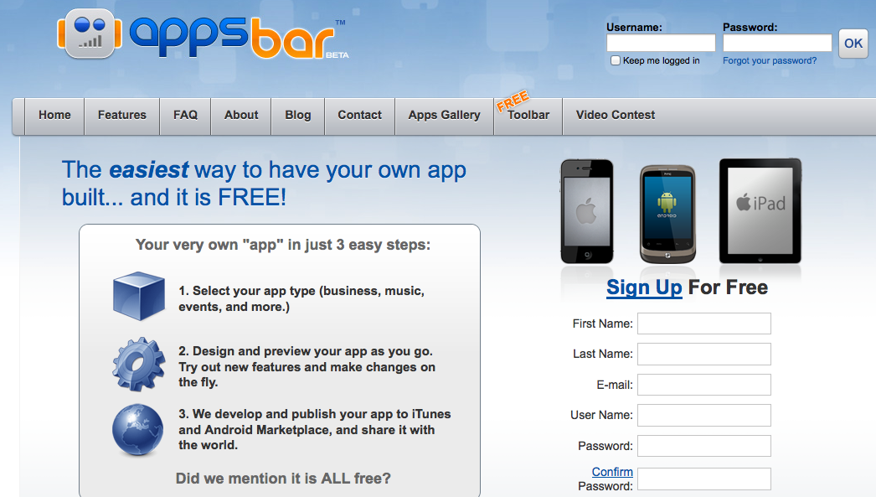
Making an App
AppsBar
This program will allow you to make your own apps for free in less than 30 minutes. AppsBar will also publish your app in the Adroid Market and in iTunes. No language programming is required to use this site.

Slide 14
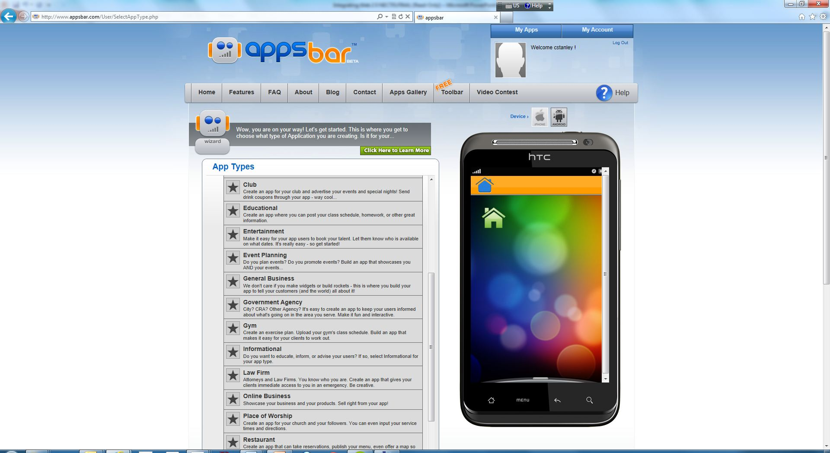
Apps Bar

Slide 15
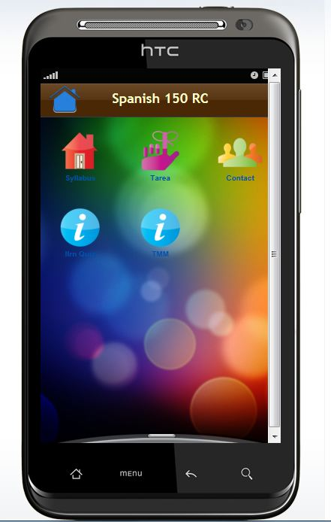
Apps Bar

Slide 16

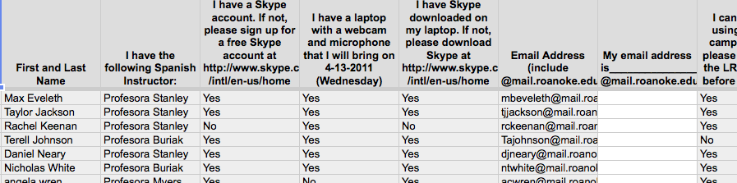
Google Docs
To make forms that can be used as sign up sheets for special events
Create an Account, Click on the Documents tool, Choose the option to create a Form
Insert a title, add any questions you want or need
Can change the theme to suit your needs
Google Documents Editor

Slide 17
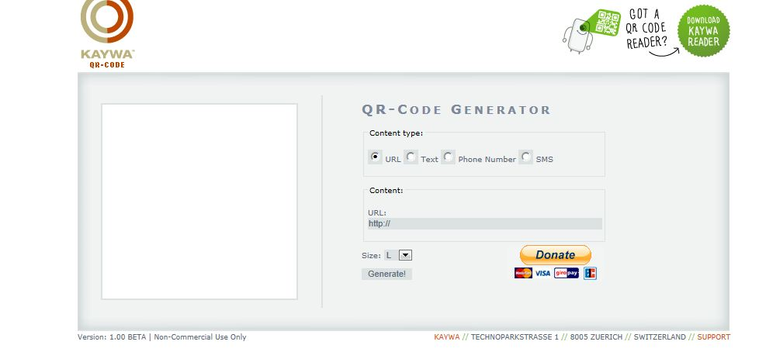
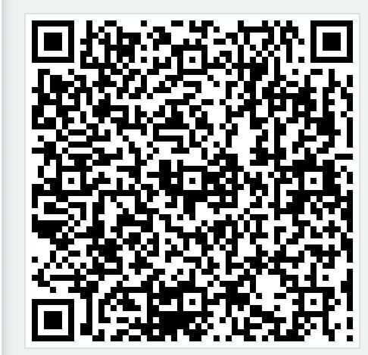
Qr Codes
Kaywa

Slide 18
How can you use Qr Codes?
Add multimedia content to hard copy pages (Tutorials, Websites, Solutions, Audio / Video Files, Contact Information, etc…)
Scavenger hunts using Qr Treasure Hunt Generator
Voting or Polls (asking questions using Webdoc.com)
Digital Story Telling (place codes around campus or on pictures around the classroom; integrate with realia)
Information Gap Activities

Slide 19
Qr Codes
Book Reviews
Creating Mnemonics (by students)
School Tours (Review directions and commands)
Students can create content
Class Announcements or Quick Warm-ups

Slide 20
Lyrics Training
Easy and fun method to learn a foreign language through music.
Game like scenario to fill in the lyrics to popular music videos.
Different levels easy, medium, hard. (See examples)
Different languages including Italian, German, English, Spanish, French etc…
Program can also translate songs (using Google Translate) as you hear them.

Slide 21
Karaoke Mode
Notes:
Giuliana

Slide 22
Levels of Lyrics Training

Slide 23
Levels of Lyrics Training
Notes:
Giuliana

Slide 24
Tools for Screen Captures
Need to make a short video capturing a computer’s screen?
Try these tools for simple screen recording:
Screen Cast O Matic 15 minutes free; 60 minutes $12 (Pro version)
JING 5 minutes free
Notes:
Christine

Slide 25
Ideas for Using Screen Captures
Students can make a weekly announcement or report about what they have learned or will be learning
Students can explain grammatical concepts presented in class
Have students capture information for their digital portfolio
Students can record questions about homework or technological issues

Slide 26
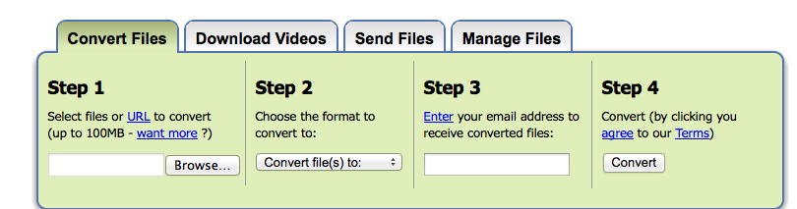
File Conversion
Zamzar
Download videos and files and convert them online without downloading any software.
Notes:
Christine

Slide 27
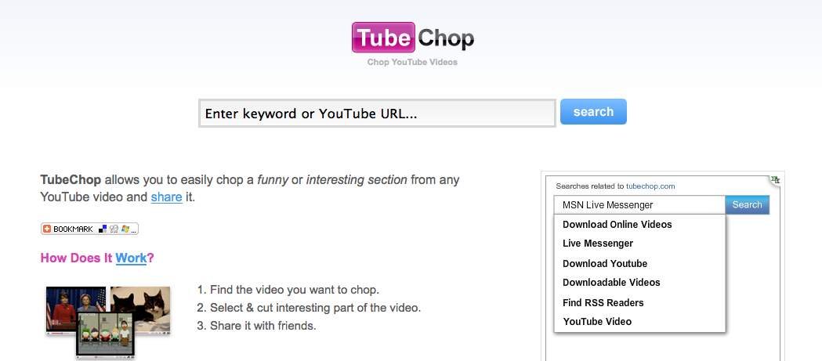
Videos
ViewPure
TubeChop
Only use what you need from a video. Use YouTube videos without seeing the comments and advertisements.
Notes:
Giuliana

Slide 28
Il postino - Massimo Troisi

Slide 29
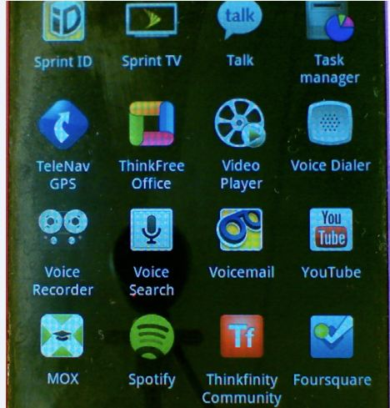
Voice Recorder Activity
Students use voice recorder App on cell phone
Make short recordings outside of class (5 seconds)
Record “sounds of the day,” “sounds of campus,” etc.

Slide 30
Voice Recorder Activity
Present in class the name of the sound (demonstrative adjectives, possessive adjectives, adjectives in general)
More advanced students can explain significance
Variation: play guessing game with students (irregular verbs, e.g. oír)

Slide 31
Cellphones
Remind101
This is a free service for teachers. Teachers can set up a maximum of 10 classes. Students (and parents) self-enroll into the class online. Texts can be sent to the entire class. Students will not have access your personal cellphone number.

Slide 32
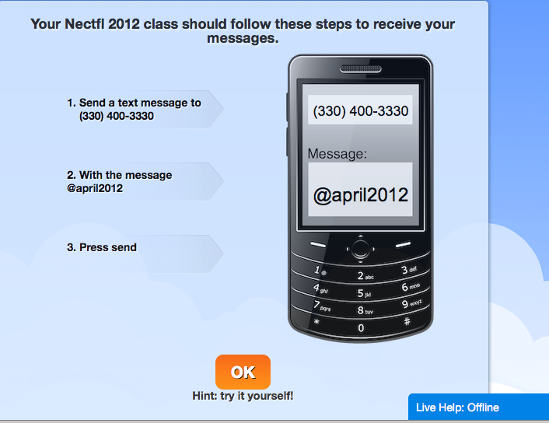
Try it now…
Notes:
Christine

Slide 33
Remind101
“I think that Remind101 is very useful for college students. On more than one occasion, this program has helped remind me of an assignment/test that I had completely forgot about. I believe that only positive things would result from more widespread usage of Remind101 on college and high school campuses.”
                Zack Lukado- Roanoke College

Slide 34
Cellphones
Celly
Text and polling (use like Clickers)
Take short online quizzes
Text to Screen (Interactive walls)
Mobile Learning
Discussions can be moderated before being posted.

Slide 35
Celly Activity
Send a text in target “text language” to students that asks a question
Students can text a response back
e.g. dv 6? (in biblioteca)
e.g. c ved ven h22? (ven no. ci ved sab?)
e.g. dove 6 and? (al cinema)
Students can come to class prepared to answer question verbally

Slide 36
How to contact us:
Christine S. Stanley
Roanoke College
Department of Modern Languages
108 Lucas Hall
540-378-5196
cstanley@roanoke.edu
Giuliana F. Chapman
Roanoke College
Department of Modern Languages
223 Lucas Hall
540-375-2082
chapman@roanoke.edu

